Slide 1
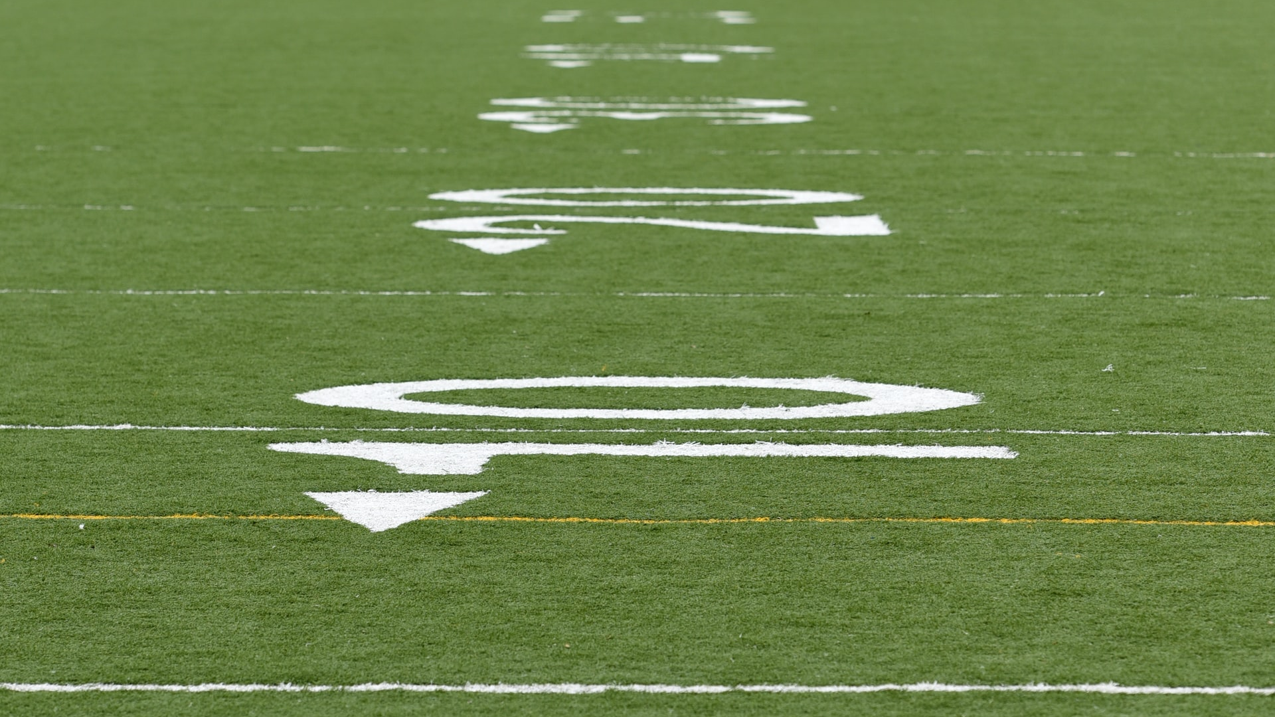
Fantasy Football Player Rankings
Dominate your League using Data Science & Analytics

Slide 2

Project Goal
To explore NFL and fantasy football data through exploratory data analysis and predictive modeling in attempt to find patterns to predict success in weekly fantasy football matchups.
Remove the randomness and guesswork out of weekly fantasy football matchups
Create a unique algorithm for all of the positions that comprise a typical fantasy football roster
Create a player ranking system that is updated each week during the season

Slide 3
Data Sources
Each week the algorithm will be fed data from NFL and fantasy football sites, in addition to weather data to generate a player score and it will be used to create a ranking system.
NFL statistics and/or data sets from Pro Football Focus
Fantasy football statistics, content, and data sets from FantasyPros
Forecasted weather data for NFL stadiums from various sites; in particular hyper-local weather data such as available via Dark Sky

Slide 4
Typical Fantasy Football Roster
Quarterback (QB)
Running Back (RB)
Wide Receiver (WR)
Tight End (TE)
Kicker (K)
Defense and Special Teams (DST)
Defensive Player (D or IDP)

Slide 5
Predicting Success in Kicking
Ask the right questions
Use kickers based upon weekly matchups
Don’t assume that good fantasy kickers are only on good football teams

Slide 6
Kickers: All Guts, No Glory
Underrated part of the game
Cushy life? Easy job?
The secret weapon
The kick heard ‘round the world

Slide 7
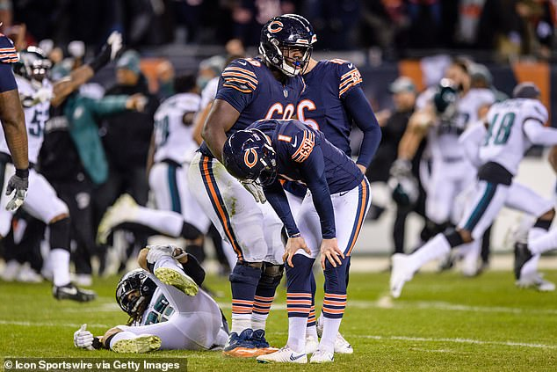

Slide 8
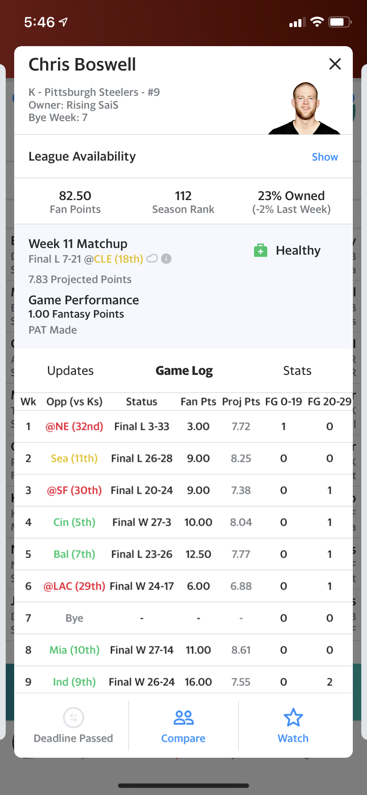
Look Familiar?

Slide 9
Kicking Algorithm Key Variables
A kicker will generate a higher ranking based upon these criteria:
A kicker with a high rate of accuracy
A kicker’s offense with a high ranking in offensive efficiency
A kicker’s offense with a low ranking in red zone efficiency
A kicker facing a defense that has a high ranking in red zone efficiency
A kicker’s team is a heavy favorite
A kicker’s team is not a heavy underdog
A kicker competing in a game that is expected to be close
The weather will not have a detrimental impact on the kicking game

Slide 10
Results

Slide 11
k_data_2018_w_12
## Name Accuracy Team Opponent Spread OU OppRZD OffRZEff OffRank Weather KPlus
## 1 Michael Badgley 100.0 LAC vs. ARI -13.0 44 12 13 7 73F, Light Wind 68
## 2 Ka’imi Fairbairn 81.5 HOU vs. TEN -6.5 41 2 3 13 Dome 67
## 3 Aldrick Rosas 95.2 NYG at PHI 7.0 46 7 6 23 55F, 7 MPH Wind 61
## 4 Jason Sanders 93.8 MIA at IND 10.0 51 9 0 28 Dome 59
## 5 Cairo Santos 83.3 TB vs. SF -3.0 54 16 15 1 80F, 7 MPH Wind 57
## 6 Mason Crosby 76.9 GB at MIN 4.0 48 1 18 8 Dome 56
## 7 Brandon McManus 82.4 DEN vs. PIT 3.0 48 13 10 11 45F, 8 MPH Wind 54
## 8 Dan Bailey 82.4 MIN vs. GB -4.0 48 11 9 14 Dome 54
## 9 Stephen Gostkowski 86.4 NE at NYJ -9.0 47 8 22 10 55F, 7 MPH Wind 52
## 10 Justin Tucker 90.5 BAL vs. OAK -12.0 43 10 21 12 55F, Light Wind 52
## 11 Dustin Hopkins 85.0 WAS at DAL 9.0 41 3 12 25 Dome 51
## 12 Brett Maher 84.0 DAL vs. WAS -9.0 41 5 8 27 Dome 50
## 13 Jake Elliott 77.8 PHI vs. NYG -7.0 46 6 11 19 55F, 7 MPH Wind 50
## 14 Josh Lambo 94.4 JAC at BUF -3.0 38 25 5 21 41F, Light Wind 46
## 15 Jason Myers 91.3 NYJ vs. NE 9.0 47 20 1 29 55F, 7 MPH Wind 46
## 16 Robbie Gould 95.5 SF at TB 3.0 54 32 4 17 80F, 7 MPH Wind 45
## 17 Adam Vinatieri 83.3 IND vs. MIA -10.0 51 15 24 9 Dome 43
## 18 Matt Bryant 100.0 ATL at NO 14.0 60 28 23 6 Dome 43
## 19 Matt Prater 86.4 DET vs. CHI 3.0 45 21 7 24 Dome 41
## 20 Wil Lutz 95.5 NO vs. ATL -14.0 60 29 28 4 Dome 37
## 21 Cody Parkey 76.2 CHI at DET -3.0 45 17 20 16 Dome 36
## 22 Steven Hauschka 93.8 BUF vs. JAC 3.0 38 14 17 31 41F, Light Wind 36
## 23 Graham Gano 91.7 CAR vs. SEA -3.0 47 18 29 15 53F, Light Wind 35
## 24 Daniel Carlson 63.6 OAK at BAL 12.0 43 22 2 22 55F, Light Wind 34
## 25 Greg Joseph 84.6 CLE at CIN 3.0 48 23 19 18 53F, 6 MPH Wind 34
## 26 Chris Boswell 72.7 PIT at DEN -3.5 48 19 30 5 45F, 8 MPH Wind 33
## 27 Ryan Succop 85.7 TEN at HOU 6.5 41 30 14 30 Dome 22
## 28 Sebastian Janikowski 75.0 SEA at CAR 3.0 47 31 25 20 53F, Light Wind 18
## 29 Randy Bullock 75.0 CIN vs. CLE -3.0 48 24 31 26 53F, 6 MPH Wind 14

Slide 12
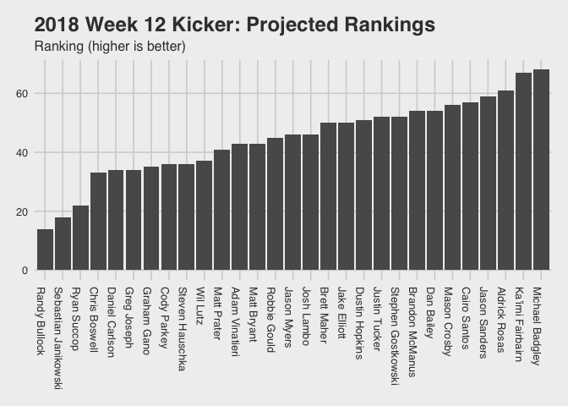

Slide 13
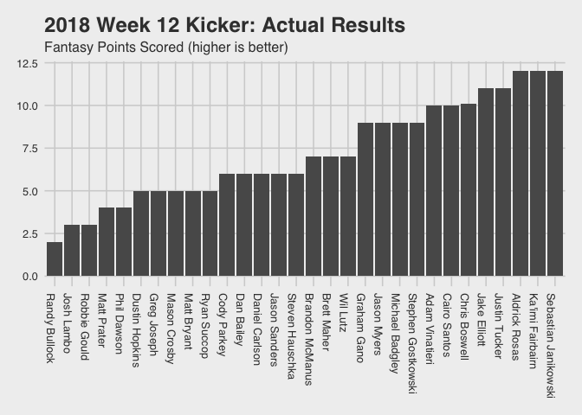

Slide 14
Conclusion

Slide 15
Conclusion
Three top projected kickers did well, as two out of the three tied for the lead in points this week, while another wasn’t too far behind them

